Slide 1
This Is Berkeley:
The Finest Public University in the World
J. Bradford Delong
http://bradford-delong.com
brad.delong@gmail.com
@delong
November 2016-12-01
key: https://www.icloud.com/keynote/08xK3nq72hgtI4bZ3o-tabvNQ
html: http://www.bradford-delong.com/2018/06/lecture-this-is-berkeley.html
Notes:
To orient ourselves, let us take the biggest-picture look at the economic history of the human race possible. The anthropologists tell us that we evolved in the Horn of Africa, becoming "anatomically modern" perhaps 200,000 years ago and "behaviorally modern"--which perhaps means acquiring _language_--less than 100,000 years ago.

Slide 2
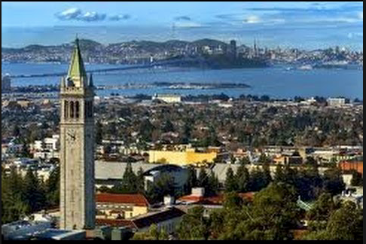
This Is Berkeley!

Slide 3
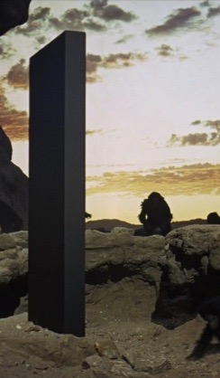
You Are Lucky to Be Here
This is the University of California at Berkeley
Certainly the finest public university in the world
Perhaps the finest university in the world
Lots of opportunities here
Others could be in your seats
They would take advantage of the opportunities here
DON’T WASTE YOUR OPPORTUNITY HERE!!
Notes:
They will spend more time on the long 20th century then on any other earlier century. It will be salient, in that more and more that is important happened in the age than in any equal earlier length of time. Between the appearance of the iron-hulled oceangoing steamship, the submarine telegraph cable, and the industrial research lab around 1870 and the business cycle collapse followed by the anemic recovery of 2007-2015, the world was transformed more and more thoroughly than in any easier epoch of its or even many times its length. The two millennia of the discovery of agriculture and herding and the unknown period that marked the discovery and diffusion of fire might have matched it, and the invention of language surpassed it. But otherwise, of all eras that the human race has experienced to date, the long 20th century was the axis on which the wheel of history turned.
This is not to say that people 2000, 3000, 4000 years from now will spend a lot of time thinking about what they will call "ancient history", and we now simply call "history": A lot of water will flow under many bridges in what will be our future and their past. But what of their attention they do focus on us and our predecessors will give a large place to us and to our four generations of immediate ancestors.
The first thing that they will stress is that the history of the long 20th century is predominantly economic, or rather political-economic history.

Slide 4
You Belong Here
We go fast here
We want to teach you a lot of stuff
You can—and should—handle it
We are confident you belong here—can take advantage of the opportunities
We are rarely wrong
Notes:
They will spend more time on the long 20th century then on any other earlier century. It will be salient, in that more and more that is important happened in the age than in any equal earlier length of time. Between the appearance of the iron-hulled oceangoing steamship, the submarine telegraph cable, and the industrial research lab around 1870 and the business cycle collapse followed by the anemic recovery of 2007-2015, the world was transformed more and more thoroughly than in any easier epoch of its or even many times its length. The two millennia of the discovery of agriculture and herding and the unknown period that marked the discovery and diffusion of fire might have matched it, and the invention of language surpassed it. But otherwise, of all eras that the human race has experienced to date, the long 20th century was the axis on which the wheel of history turned.
This is not to say that people 2000, 3000, 4000 years from now will spend a lot of time thinking about what they will call "ancient history", and we now simply call "history": A lot of water will flow under many bridges in what will be our future and their past. But what of their attention they do focus on us and our predecessors will give a large place to us and to our four generations of immediate ancestors.
The first thing that they will stress is that the history of the long 20th century is predominantly economic, or rather political-economic history.

Slide 5
A Word or Two on a Liberal Education
This is an investment by you in you:
A “liberal education”
Surprise benefits
The value to you of a liberal education
This is an investment by the state of California:
The value to us of your getting a liberal education
This is an investment by the human race:
The value to us of your getting a liberal education
This carries not just privileges and immunities, but responsibilities and obligations
Notes:
They will spend more time on the long 20th century then on any other earlier century. It will be salient, in that more and more that is important happened in the age than in any equal earlier length of time. Between the appearance of the iron-hulled oceangoing steamship, the submarine telegraph cable, and the industrial research lab around 1870 and the business cycle collapse followed by the anemic recovery of 2007-2015, the world was transformed more and more thoroughly than in any easier epoch of its or even many times its length. The two millennia of the discovery of agriculture and herding and the unknown period that marked the discovery and diffusion of fire might have matched it, and the invention of language surpassed it. But otherwise, of all eras that the human race has experienced to date, the long 20th century was the axis on which the wheel of history turned.
This is not to say that people 2000, 3000, 4000 years from now will spend a lot of time thinking about what they will call "ancient history", and we now simply call "history": A lot of water will flow under many bridges in what will be our future and their past. But what of their attention they do focus on us and our predecessors will give a large place to us and to our four generations of immediate ancestors.
The first thing that they will stress is that the history of the long 20th century is predominantly economic, or rather political-economic history.

Slide 6
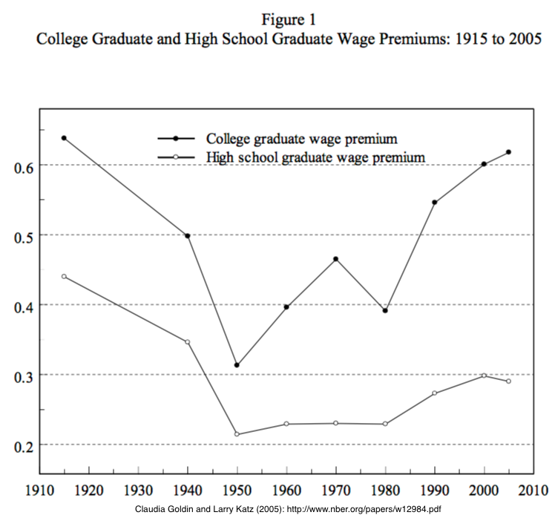
What Is a “Liberal Education”?
“Liberal education” ≠ “kinda left-wing education” here
“Liberal education” here means “appropriate to somebody free”
Someone with control over their own destiny
Someone with a share of control over our common destinies
Notes:
They will spend more time on the long 20th century then on any other earlier century. It will be salient, in that more and more that is important happened in the age than in any equal earlier length of time. Between the appearance of the iron-hulled oceangoing steamship, the submarine telegraph cable, and the industrial research lab around 1870 and the business cycle collapse followed by the anemic recovery of 2007-2015, the world was transformed more and more thoroughly than in any easier epoch of its or even many times its length. The two millennia of the discovery of agriculture and herding and the unknown period that marked the discovery and diffusion of fire might have matched it, and the invention of language surpassed it. But otherwise, of all eras that the human race has experienced to date, the long 20th century was the axis on which the wheel of history turned.
This is not to say that people 2000, 3000, 4000 years from now will spend a lot of time thinking about what they will call "ancient history", and we now simply call "history": A lot of water will flow under many bridges in what will be our future and their past. But what of their attention they do focus on us and our predecessors will give a large place to us and to our four generations of immediate ancestors.
The first thing that they will stress is that the history of the long 20th century is predominantly economic, or rather political-economic history.

Slide 7
What Is a “Liberal Education”? II
Someone with control over their own and a share of control over our common destinies
Not someone taught a particular skill to do one thing
But, rather, someone whose life will be spent in a wide range of activities
And who thus needs a wide range of knowledge
Notes:
They will spend more time on the long 20th century then on any other earlier century. It will be salient, in that more and more that is important happened in the age than in any equal earlier length of time. Between the appearance of the iron-hulled oceangoing steamship, the submarine telegraph cable, and the industrial research lab around 1870 and the business cycle collapse followed by the anemic recovery of 2007-2015, the world was transformed more and more thoroughly than in any easier epoch of its or even many times its length. The two millennia of the discovery of agriculture and herding and the unknown period that marked the discovery and diffusion of fire might have matched it, and the invention of language surpassed it. But otherwise, of all eras that the human race has experienced to date, the long 20th century was the axis on which the wheel of history turned.
This is not to say that people 2000, 3000, 4000 years from now will spend a lot of time thinking about what they will call "ancient history", and we now simply call "history": A lot of water will flow under many bridges in what will be our future and their past. But what of their attention they do focus on us and our predecessors will give a large place to us and to our four generations of immediate ancestors.
The first thing that they will stress is that the history of the long 20th century is predominantly economic, or rather political-economic history.

Slide 8
Privileges and Immunities
A liberal education is a very valuable thing
Difference in the natural log (ln) of 0.6 means that:
the higher number is 1 + 0.6 + (0.6)^2/(2!) + (0.6)^3/(3!) + (0.6)^4/(4!)+ …
= 1.8221 times the lesser:
is 82% higher.
Notes:
They will spend more time on the long 20th century then on any other earlier century. It will be salient, in that more and more that is important happened in the age than in any equal earlier length of time. Between the appearance of the iron-hulled oceangoing steamship, the submarine telegraph cable, and the industrial research lab around 1870 and the business cycle collapse followed by the anemic recovery of 2007-2015, the world was transformed more and more thoroughly than in any easier epoch of its or even many times its length. The two millennia of the discovery of agriculture and herding and the unknown period that marked the discovery and diffusion of fire might have matched it, and the invention of language surpassed it. But otherwise, of all eras that the human race has experienced to date, the long 20th century was the axis on which the wheel of history turned.
This is not to say that people 2000, 3000, 4000 years from now will spend a lot of time thinking about what they will call "ancient history", and we now simply call "history": A lot of water will flow under many bridges in what will be our future and their past. But what of their attention they do focus on us and our predecessors will give a large place to us and to our four generations of immediate ancestors.
The first thing that they will stress is that the history of the long 20th century is predominantly economic, or rather political-economic history.

Slide 9
Privileges and Immunities II
At a $40,000/year average earnings level…
82.2% x $40,000/year =$32,884/year
Go to college: invest $15K/yr (tuition and fees) + $20K/yr (earnings not made) for 5 years = $175,000
Get an extra $32,884/year for 40 years if you’re the kind of person who can graduate
Plus: freedom, depth of experience…
Notes:
They will spend more time on the long 20th century then on any other earlier century. It will be salient, in that more and more that is important happened in the age than in any equal earlier length of time. Between the appearance of the iron-hulled oceangoing steamship, the submarine telegraph cable, and the industrial research lab around 1870 and the business cycle collapse followed by the anemic recovery of 2007-2015, the world was transformed more and more thoroughly than in any easier epoch of its or even many times its length. The two millennia of the discovery of agriculture and herding and the unknown period that marked the discovery and diffusion of fire might have matched it, and the invention of language surpassed it. But otherwise, of all eras that the human race has experienced to date, the long 20th century was the axis on which the wheel of history turned.
This is not to say that people 2000, 3000, 4000 years from now will spend a lot of time thinking about what they will call "ancient history", and we now simply call "history": A lot of water will flow under many bridges in what will be our future and their past. But what of their attention they do focus on us and our predecessors will give a large place to us and to our four generations of immediate ancestors.
The first thing that they will stress is that the history of the long 20th century is predominantly economic, or rather political-economic history.

Slide 10

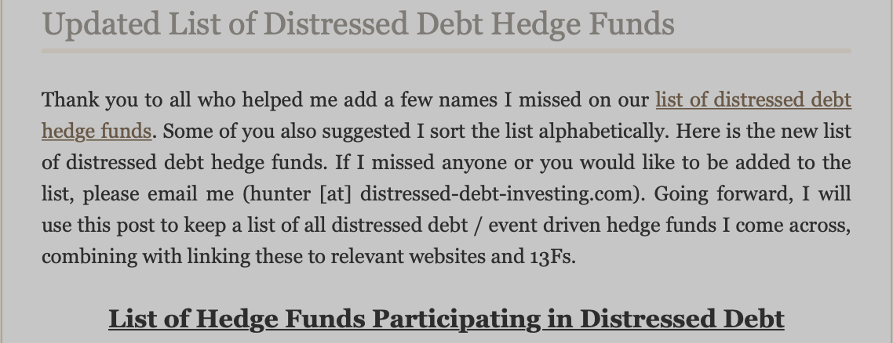
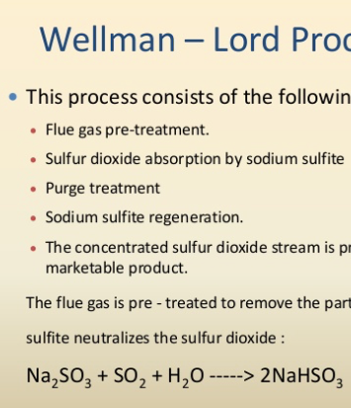

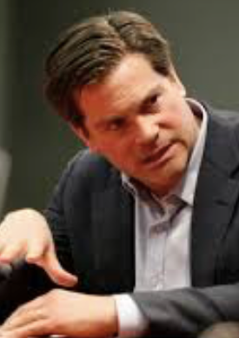
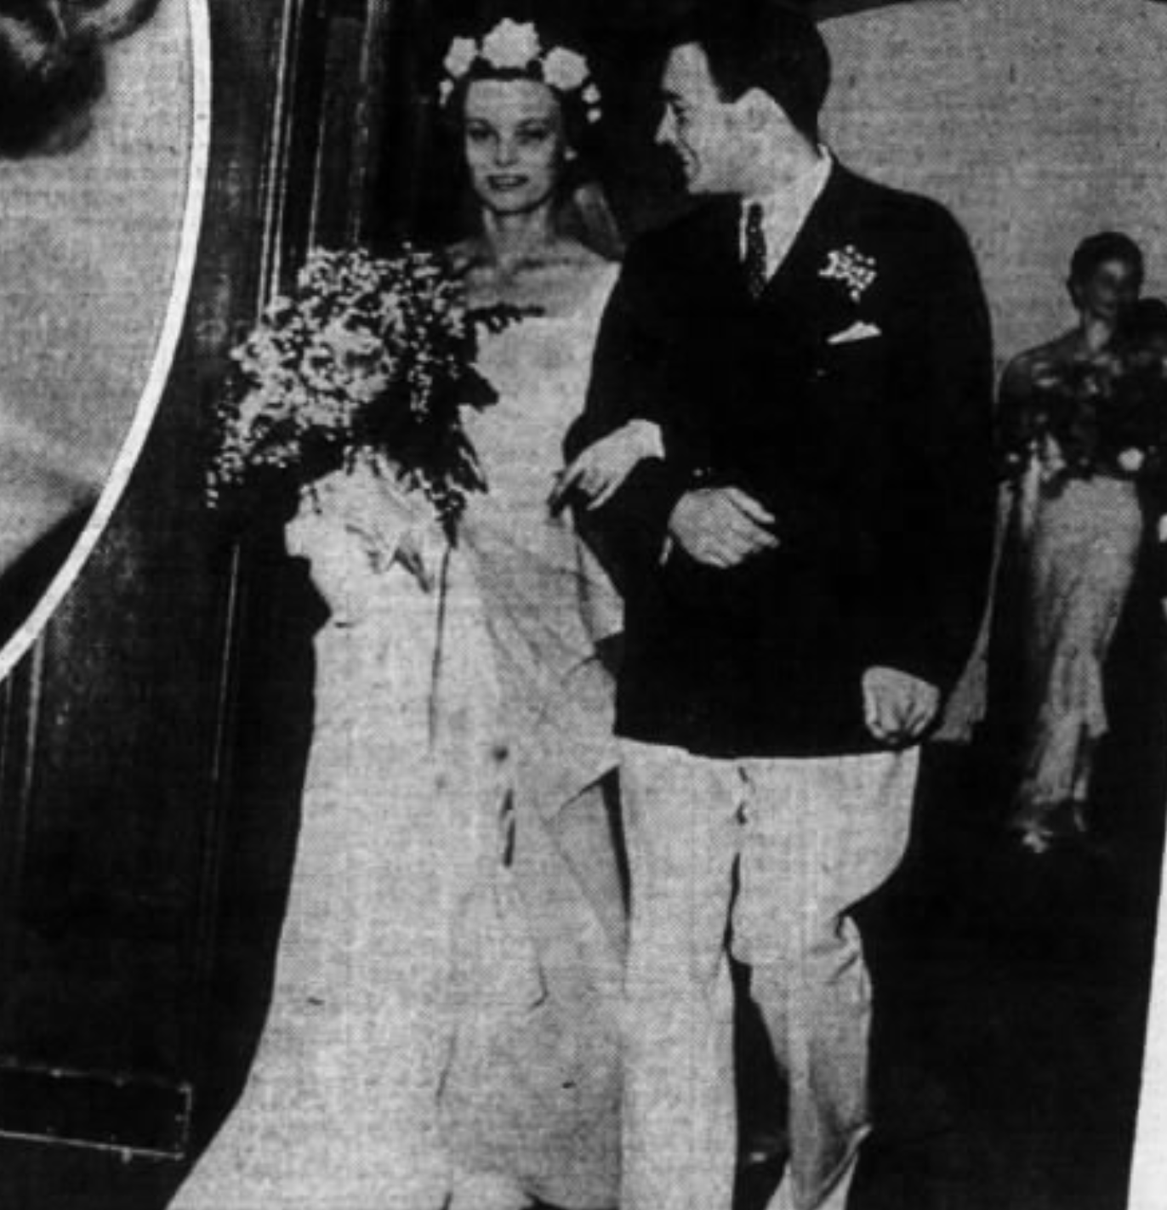
It is Not the “Technical” Training That Is the Most Valuable
In my extended family, three people who were, are, or look like they are headed for not the top 1% but the top 0.1%…
Industries:
construction and chemical engineering (ultimately pollution control)
“smart money” on Wall Street managing the flow of financing of investment,
“the industry” as they call it in LA…
Notes:
They will spend more time on the long 20th century then on any other earlier century. It will be salient, in that more and more that is important happened in the age than in any equal earlier length of time. Between the appearance of the iron-hulled oceangoing steamship, the submarine telegraph cable, and the industrial research lab around 1870 and the business cycle collapse followed by the anemic recovery of 2007-2015, the world was transformed more and more thoroughly than in any easier epoch of its or even many times its length. The two millennia of the discovery of agriculture and herding and the unknown period that marked the discovery and diffusion of fire might have matched it, and the invention of language surpassed it. But otherwise, of all eras that the human race has experienced to date, the long 20th century was the axis on which the wheel of history turned.
This is not to say that people 2000, 3000, 4000 years from now will spend a lot of time thinking about what they will call "ancient history", and we now simply call "history": A lot of water will flow under many bridges in what will be our future and their past. But what of their attention they do focus on us and our predecessors will give a large place to us and to our four generations of immediate ancestors.
The first thing that they will stress is that the history of the long 20th century is predominantly economic, or rather political-economic history.

Slide 11
It is Not the “Technical” Training That Is the Most Valuable
What was valuable?:
learning how to deal socially as a (relative) outsider at Harvard in the 1920s,
historical-critical source analysis in the 1980s,
messing around with Dartmouth AV in the 1990s
Notes:
They will spend more time on the long 20th century then on any other earlier century. It will be salient, in that more and more that is important happened in the age than in any equal earlier length of time. Between the appearance of the iron-hulled oceangoing steamship, the submarine telegraph cable, and the industrial research lab around 1870 and the business cycle collapse followed by the anemic recovery of 2007-2015, the world was transformed more and more thoroughly than in any easier epoch of its or even many times its length. The two millennia of the discovery of agriculture and herding and the unknown period that marked the discovery and diffusion of fire might have matched it, and the invention of language surpassed it. But otherwise, of all eras that the human race has experienced to date, the long 20th century was the axis on which the wheel of history turned.
This is not to say that people 2000, 3000, 4000 years from now will spend a lot of time thinking about what they will call "ancient history", and we now simply call "history": A lot of water will flow under many bridges in what will be our future and their past. But what of their attention they do focus on us and our predecessors will give a large place to us and to our four generations of immediate ancestors.
The first thing that they will stress is that the history of the long 20th century is predominantly economic, or rather political-economic history.

Slide 12
Catch Our Breath…
Comments?
Questions?
What's next?

